Slide 1
PKI and Secrets with Vault
as analyzed and reported here
p.pires@travelaudience.com

Slide 2
Agenda
Problem and Solution
Vault 101
Deploy Vault
Authenticate as an operator
Setup a Public-Key Infrastructure
Disaster recovery
kubernetes-vault-client
Example: time-server
Questions?

Slide 3
Problem and Solution

Slide 4
The problem
At Travel Audience, we need to centrally manage and encrypt sensitive information such as database passwords or third-party service credentials.
These pieces of sensitive information, from now on referred to as secrets, must be made available to (but not just) applications running in our Kubernetes clusters, in a secure and controlled way.
We also need to establish a public-key infrastructure (PKI) capable of issuing both client and server TLS certificates used for establishing trust between our applications (mutual authentication (mTLS)).

Slide 5
The problem
At first glance, these needs could be easily addressed by using Kubernetes secrets and a tool like openssl to help establish a PKI.
However, this simple approach has a few important limitations:
Secret objects are bound to one namespace. They can only be referenced by pods in that same namespace.
Kubernetes offers little to no control over who can access one or more secrets.
Can’t share secrets between applications running in different clusters.
Kubernetes does not (yet) support encryption of secrets at rest.

Slide 6
Acceptance criteria for a solution
The chosen solution must:
enable authentication of applications, trust establishment between applications, and secure secret management;
be usable by applications running in different Kubernetes clusters or in different GCP projects - for as long as the GCP organization is the same (hint: Cloud IAM);
be secure and tightly integrated with both GCP services and Kubernetes.

Slide 7
The solution
After an exhaustive evaluation of a few secret management tools at our disposal, we decided to build our solution on top of Hashicorp Vault.
Besides the fact that Vault delivers pretty much all we are looking for, this decision was also motivated by:
Vault is OSS
Vault’s security model is mature
Broad adoption (big and active community)

Slide 8
Vault 101

Slide 9
Vault
Vault is a tool for managing secrets that “secures, stores, and tightly controls access to tokens, passwords, certificates, API keys and other secrets in modern computing”.
As described, Vault stores existing secrets such as database passwords and also dynamically generates new ones such as certificates used for establishing mTLS.

Slide 10
Vault: writing and reading a secret
$ vault write secret/postgresql username="myapp" password="s4f3#p455w0rd!"
Success! Data written to: secret/postgresql
$ vault read secret/postgresql
Key Value
--- -----
password s4f3#p455w0rd
username myapp

Slide 11
Vault: Secret backends
Vault supports several different secret backends—components that store and generate secrets. To deliver the proposed solution we will make heavy use of the kv and pki [types of] secret backends.
The kv backend stores and returns arbitrary strings (such as s4f3#p455w0rd! in the previous example). A secret managed by a kv backend secret may have multiple fields (such as username and password in the previous example). After all, kv stands for key-value, hence it’s a map.
The pki backend generates and manages private keys and certificates used for establishing TLS. It supports several different configuration parameters.

Slide 12
Vault: Secret backends
Before being used, secret backends must be mounted at a given path. In the context of Vault, mounting a secret backend means creating a new, isolated instance of the backend.
By default Vault mounts an instance of the kv backend at secret/, and that is what we have used in the previous example. All other secret backends must be explicitly mounted and configured.
There may be any number of secret backends mounted at any given time, and it is possible to have multiple instances of the same secret backend mounted at different paths and using different configurations.
Unmount is a destructive operation!

Slide 13
Vault: Secret backends
$ vault mount -path supersecret kv
Successfully mounted 'kv' at 'supersecret'!
$ vault write supersecret/foo bar=baz
Success! Data written to: supersecret/foo
$ vault read -field="bar" supersecret/foo
baz
$ vault read -field="bar" secret/foo
No value found at secret/foo
Notes:
The kv backends mounted at secret/ and supersecret/ are independent and do not share any data.

Slide 14
Vault: Authentication
Vault features an HTTP API through which every single request flows. This API is used by both operators and applications in order to store and retrieve secrets and/or certificates.
Vault’s authentication model is based on the concept of tokens. Each token has an associated set of policies and may or may not have a defined time-to-live.
A token may be obtained directly from Vault or by using an external authentication provider. Vault has first-class support for Kubernetes and Cloud IAM as authentication providers, making it easy to provide Kubernetes/GCP applications with tokens. We will focus on Kubernetes alone!

Slide 15
Vault: Authentication
Vault’s support for external authentication providers is implemented in the form of auth backends—a component that performs authentication against an external source and returns Vault auth tokens associated with a set of policies on success.
Auth backends support configuration parameters such as the set of policies or the time-to-live to associate with the tokens.
More advanced backends support the concept of role—a set of constraints on the entities that may authenticate with the backend. These backends usually allow for configuring policies and TTLs on a per-role basis.

Slide 16
Vault: Authentication
In order to be used, an auth backend must be mounted at a given path. For instance, the command
$ vault auth-enable -path vault-training kubernetes
mounts an auth backend of type kubernetes at auth/vault-training. This auth backend may then be configured as necessary.
There may be any number of auth backends mounted at any time, and it is possible to mount multiple instances of the same auth backend at different paths. Each instance of an auth backend has its own configuration.

Slide 17
Vault: Authentication
Some backends are more suitable for user authentication—such as github and ldap—while some others are more suitable for application authentication—such as kubernetes. Some others, like gcp, are suitable for both since they leverage on abstractions such as service accounts.
Some of the auth backends allow for defining multiple roles. A role is a mapping between a specific external entity, such as a particular Kubernetes service account, and a set of Vault policies. We’ll have a deeper look at roles in a short while.

Slide 18
Vault: Authorization
While authentication may be delegated to an external provider such as Cloud IAM or Kubernetes, authorization is fully managed within Vault using policies—sets of rules which control what paths in the API can be accessed, and how.
For instance, a policy may specify that the bearer of a given token has read-only access to secret/postgresql:
path "secret/postgresql" { capabilities = ["read"] }
Any token associated with this policy will be able to read—but not modify—the postgresql secret.

Slide 19
Vault: Authorization
There are two pre-defined policies in Vault—root and default. The former allows full access to the Vault API while the latter allows only very basic functionality that all users should be allowed such as looking-up or revoking their own token.
User-defined policies work on a deny-by-default basis, and can be made as permissive as desired. For instance, and assuming a kv secret backend is mounted at bidder, this policy allows full control over the contents of the backend
path "bidder/*" {
capabilities = ["create", "read", "update", "delete", "list"]
}
We’ll refer to this policy as bidder-rw in the next slides.
Notes:
ATTENTION: This policy does not allow controll over the backend itself (i.e., mounting or unmounting), only over the contents.

Slide 20
Vault: Authorization
 | bidder-rw | root
Read secrets on secret/ | ⤫ | ✓
Create secrets on bidder/ | ✓ | ✓
Update secrets on bidder/ | ✓ | ✓
Read secrets on bidder/ | ✓ | ✓
Delete a secret on bidder/ | ✓ | ✓
List secrets on bidder/ | ✓ | ✓
Unmount bidder/ | ⤫ | ✓

Slide 21
Vault: Authorization
As mentioned before, some auth backends like gcp and kubernetes may be configured to map specific external entities into a set of policies.
For instance, we may create a bidder-secret-provisioner Cloud IAM service account and instruct the gcp backend to map it to the bidder-rw policy:
$ vault write /auth/gcp/roles/bidder-secret-provisioner \
type="iam" project_id="bidder-152710" ttl="1h" \
policies="bidder-rw" \
bound_service_accounts="bidder-secret-provisioner@bidder-152710.iam.gserviceaccount.com"
This set of rules define the bidder-secret-provisioner role.

Slide 22
Vault: Authentication and Authorization
The bidder-secret-provisioner role makes it easy for the bidder team to manage their own secrets autonomously. All that is necessary is a private key for bidder-secret-provisioner@bidder-152710.iam.gserviceaccount.com, which may be retrieved from the GCP console or using gcloud.
A member of the bidder team wanting to provision secrets needs only to login against the bidder-secret-provisioner role using a signed JWT token. If login is successful, the gcp backend will return a Vault authentication token associated with the bidder-rw policy and with a TTL of one hour, as configured. The provisioner then vault auths with the auth token and starts provisioning secrets.

Slide 23
Vault: Authentication and Authorization
If this proves to be a useful strategy, we may agree on having permissive policies such as bidder-rw and corresponding roles on the gcp backend on a per-team basis, so that every team may provision their secrets autonomously.
It should be noted, however, that this represents a compromise between security and ease of use. For instance, an ill-intentioned member from a different team with sufficient Cloud IAM permissions on the organization can impersonate the bidder-secret-provisioner@bidder-152710.iam.gserviceaccount.com service account and modify or destroy secrets on the bidder/ secret backend.
In an ideal scenario only operators should be given such permissive policies.

Slide 24
Vault: A word on “roles”
Now that we’ve seen what a role represents in the context of an auth backend, we should also mention that some secret backends—most notably the pki backend—also support the concept of role. These are completely different concepts.
A role in the context of the pki backend represents a set of rules over what domain names, IPs and certificate types (client or server) are acceptable to be requested from the backend. These roles have nothing to do with authentication or authorization—only with the properties of generated certificates.

Slide 25
Vault: Storage and Encryption
Vault relies on an external storage backend such as etcd to store data and state. All data is encrypted using the Advanced Encryption Standard (AES) algorithm before being stored and cannot be decrypted by brute-force or similar attacks.
At present, there is no known practical attack that would allow someone to read data encrypted by AES without knowledge of the encryption key in use.
Storage backends also play a key role on high-availability. We will use etcd as the storage backend for our solution, due to its reliability, its support for HA and its ease of setup in Kubernetes (etcd-operator).

Slide 26
Vault: Initialization
Before using Vault, we need to initialize it, namely:
Generate the encryption key - to be used by Vault as the primary encryption key used to encrypt everything, except itself.
Generate the master key - to be used by Vault to encrypt the encryption key. This key is never stored. Instead, and by default, it is split into five parts called the unseal keys, to be distributed among trusted individuals (not stored by Vault). Also by default, a set of three unseal keys is needed for the reconstruction of the master key. By splitting and distributing the master key Vault ensures no single point of failure exists regarding data.

Slide 27
Vault: Initialization
During initialization, Vault also generates a “special” authentication token called the initial root token. This is the token associated with the root policy—thus allowing for full control over Vault—and is special in the sense that it never expires and allows for creating other “root tokens” with no expiration date.
This token can be extremely useful in development and testing scenarios but should be handled with care in production scenarios. In fact, it is a recommended action to revoke the initial root token as soon as possible after it is issued.

Slide 28
Vault: Unsealing
After initialization—as well as when it restarts—Vault enters the sealed state. This means that Vault has forgotten about the master key and cannot decrypt the encryption key—thus being unable to encrypt or decrypt data.
In order to encrypt or decrypt data Vault must be unsealed. The unsealing process consists, by default, in providing Vault with three out of the five unseal keys, thus allowing Vault to reconstruct the master key. Vault is then able to decrypt the stored encryption key and start servicing requests.
Again, Vault does not store the master key or the unseal keys. If these are somehow lost all data stored by Vault is lost as well.

Slide 29
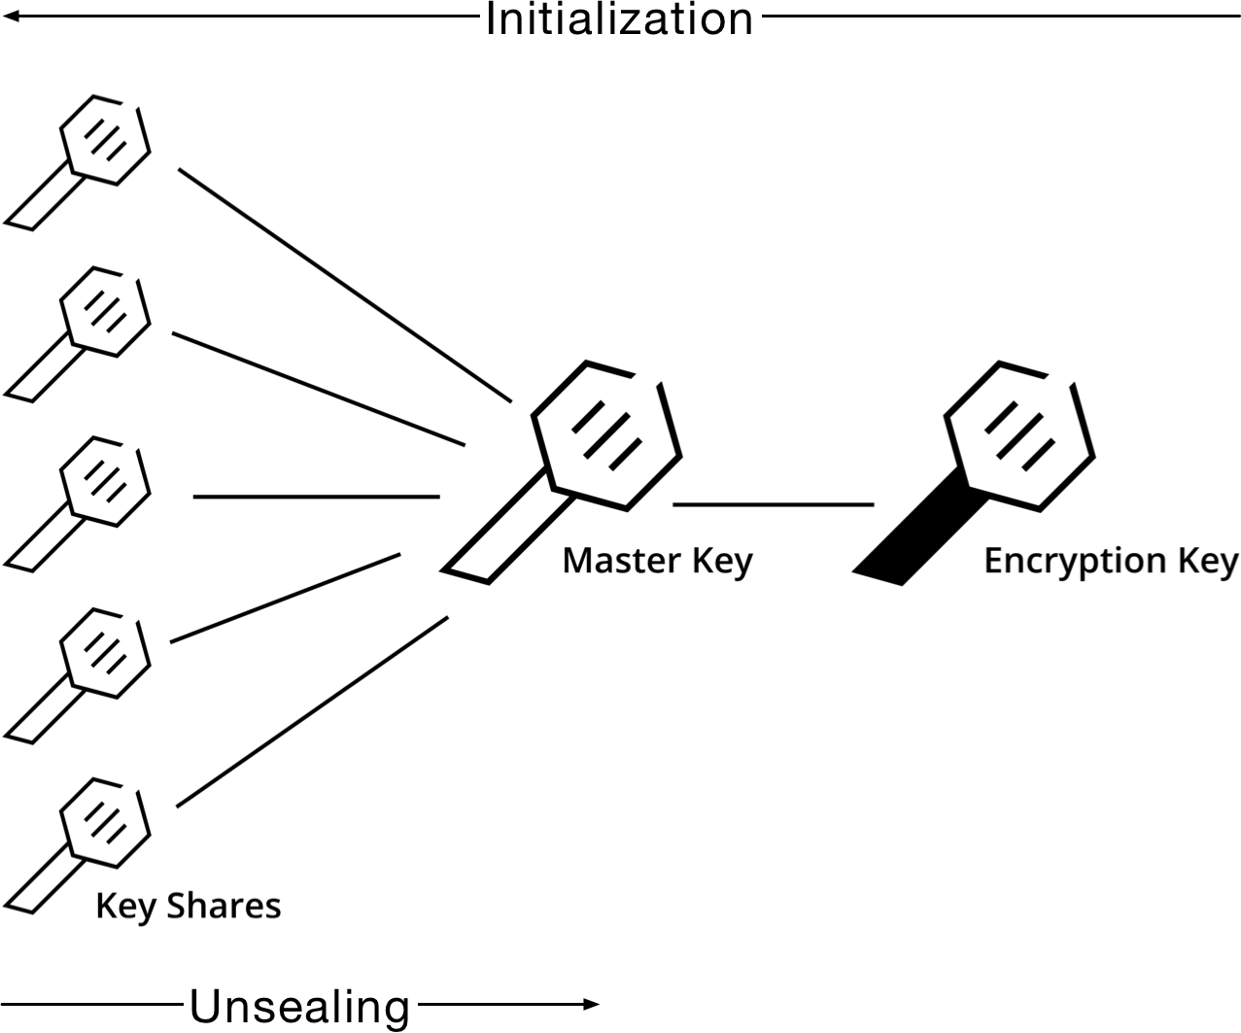
Vault: Initialization and Unsealing

Slide 30
Vault: Sealing
The reverse of the unsealing process is called sealing.
This procedure instructs Vault to forget about the master key so that no further requests can be serviced. It is an emergency procedure and should be adopted whenever an intrusion is detected to minimize the risk of exposure.
After Vault is sealed a new unsealing process is required.

Slide 31
Vault & Google Cloud KMS
As an additional security measure, and since we will deploy Vault on top of GCP, Google Cloud KMS will be used to safely store the unseal keys.
Cloud KMS is a key management service that allows for encrypting and decrypting data using strong algorithms. Being tightly integrated with Cloud IAM, adequate permissions must be established so that only trusted individuals can unseal Vault, even in a disaster scenario where all but one trusted individuals are unavailable.

Slide 32
Vault & Google Cloud KMS
Central to Cloud KMS are the concepts of keyring and key—respectively, a named grouping of keys similar to a keychain and a named object representing a cryptographic key.
Keyrings hold multiple keys and may be manipulated by individuals or service accounts with Cloud KMS Admin permissions on the organization or the project (that runs Vault).
Keys hold the actual cryptographic material used to encrypt and decrypt data. Data may be decrypted by individuals with Cloud KMS CryptoKey Decrypter permission on the organization or the project. This permission should be given only to trusted individuals as it may compromise the security of the solution.

Slide 33
Authentication with Kubernetes

Slide 34
Authentication with Kubernetes
As already mentioned, Vault has first-class support for authenticating applications running in Kubernetes clusters (Kubernetes service-accounts), making it easy to provide them with Vault authentication tokens.
To receive a Vault authentication token, applications have to login against a cluster-specific kubernetes auth backend using the service account token injected by Kubernetes in the pod they are running in.
When the auth backend receives a login request, it verifies the authenticity of the service account token against the Kubernetes API and, if successful, returns a Vault token to the application.

Slide 35
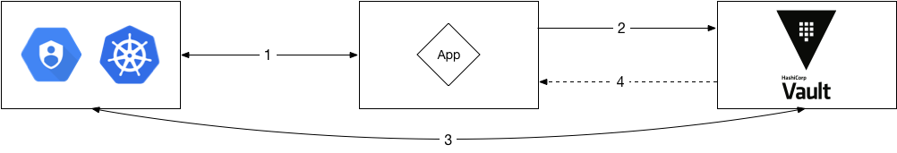
Authentication with Kubernetes
Notes:
The application obtains a signed token representing its identity. This token is the service account token mounted by Kubernetes on the pod in which the application runs.
The application sends the signed token to Vault in a login request for a given role.
Vault verifies the authenticity of the signed token using the source Kubernetes cluster’s API.
If verification is successful Vault returns an authentication token to the application. This token can be used by the application to request secrets from the Vault API, subject to the policies associated with the role.

Slide 36
Authentication with Kubernetes
If the Kubernetes cluster, where a given application is running, has RBAC enabled it is necessary to grant access to the TokenReview API for every combination of namespace and service account in use by creating a ClusterRoleBinding that includes said combinations.
For example, to authenticate with Vault using the default service account in namespaces nsone and nstwo it is necessary to create the following ClusterRoleBinding:

Slide 37
Authentication with Kubernetes
apiVersion: rbac.authorization.k8s.io/v1
kind: ClusterRoleBinding
metadata:
name: tokenreview-binding
roleRef:
apiGroup: rbac.authorization.k8s.io
kind: ClusterRole
name: system:auth-delegator
subjects:
- kind: ServiceAccount
name: default
namespace: nsone
- kind: ServiceAccount
name: default
namespace: nstwo

Slide 38
Authentication with Cloud IAM

Slide 39
Authentication with Cloud IAM
Vault also supports authenticating applications using Cloud IAM service accounts. To receive a Vault authentication token, applications have to login against a gcp auth backend using a signed JWT token obtained from the Cloud IAM API.
When the auth backend receives a login request it verifies the authenticity of the token against the Cloud IAM API and, if successful, returns a Vault token.
This flow differs from the Kubernetes-specific flow in that a service account private key must be provided to the application and adequate permissions must be set on every GCP project. As such, Kubernetes auth is preferred over Cloud IAM auth for new applications and deployments.

Slide 40
Authentication with Cloud IAM
Notes:
The application obtains a signed token representing its identity.
The application sends the signed token to Vault in a login request for a given role.
Vault verifies the authenticity of the signed token using the Cloud IAM API.
If verification is successful Vault returns an authentication token to the application. This token can be used by the application to request secrets from the Vault API, subject to the policies associated with the role.

Slide 41
Exposing Vault

Slide 42
Exposing Vault
The final part of our solution involves exposing Vault to multiple Kubernetes clusters.
We have proposed that Vault is exposed via a public, TLS-enabled GCLB associated with a given global IP address.
This allow us to keep complexity to a minimum while not compromising on the security and cost of the solution.

Slide 43
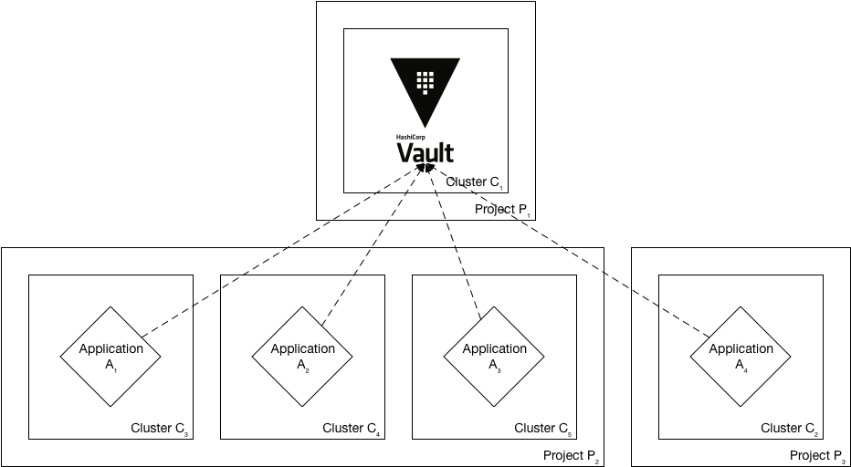
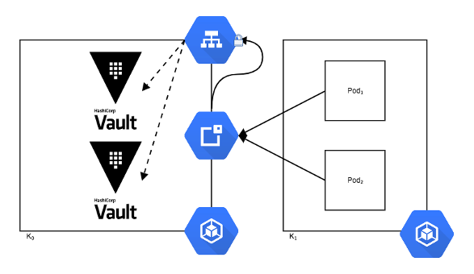
Exposing Vault
Notes:
Applications in different clusters and projects communicating with Vault.
The proposed configuration allows for applications running in separate clusters and projects to access Vault, providing an effective inter-cluster, inter-project solution.

Slide 44
Deployment pre-requisites

Slide 45
Google Cloud Platform: Requirements
A GCP project:
Google Cloud Key Management Service (KMS) API enabled
Google Cloud IAM roles:
Cloud KMS > Cloud KMS Admin
Cloud KMS > Cloud KMS CryptoKey Encrypter/Decrypter
Container > Container Engine Admin
Compute Engine > Compute Network Admin
A working GKE cluster:
Kubernetes v1.8.4
Legacy authorization disabled
Read/Write permissions for storage
Notes:
In the workstation:
gcloud + kubectl
cfssl
jq
Vault
gcloud container clusters get-credentials core-vault --zone europe-west1-b --project core-services-153312

Slide 46
Setup Google Cloud KMS
As mentioned before one will use Google Cloud KMS to add an extra layer of security to the Vault deployment.
To do that one will create a Google Cloud KMS keyring (vault) and two Google Cloud KMS keys (etcd and init) with which to encrypt and decrypt data.
The etcd key will be used to encrypt the certificates and private keys used to secure etcd—as these can’t be managed by Vault—and the init key will encrypt data generated during initialization—the unseal keys and the initial root token.

Slide 47
Setup Google Cloud KMS (DONE!)
$ gcloud kms keyrings create vault \
--location global
$ gcloud kms keys create etcd \
--location global --keyring vault --purpose encryption
$ gcloud kms keys create init \
--location global --keyring vault --purpose encryption

Slide 48
Setup RBAC on GKE
Due to a known issue with RBAC on GKE one must grant themselves the cluster-admin role manually before proceeding.

Slide 49
Setup RBAC on GKE
$ MY_GCLOUD_USER=$(gcloud info | grep Account | awk -F'[][]' '{print $2}')
$ kubectl create clusterrolebinding \
demo-cluster-admin \
--clusterrole=cluster-admin \
--user=${MY_GCLOUD_USER}
clusterrolebinding "demo-cluster-admin" created
Notes:
demo-cluster-admin may be changed to something else.

Slide 50
Deploy Vault

Slide 51
Create the vault namespace
To better group and manage the components of the solution it is recommended to create a dedicated vault namespace in the cluster.

Slide 52
Create the vault namespace
$ kubectl create namespace vault
namespace "vault" created

Slide 53
Deploy etcd-operator
etcd-operator will be responsible for managing the etcd cluster that Vault will use as storage backend.
etcd-backup-operator and etcd-restore-operator will, in turn, handle tasks such as periodic backups and disaster recovery.
Make sure to have cloned https://github.com/travelaudience/kubernetes-vault.

Slide 54
Deploy etcd-operator
$ kubectl create -f ./etcd-operator/etcd-operator-bundle.yaml
clusterrole "etcd-operator" created
serviceaccount "etcd-operator" created
clusterrolebinding "etcd-operator" created
deployment "etcd-operator" created
deployment "etcd-backup-operator" created
deployment "etcd-restore-operator" created
service "etcd-restore-operator" created

Slide 55
Verify etcd-operator
At this point it is a good idea to check whether the deployments succeeded.

Slide 56
Verify etcd-operator
$ kubectl -n vault get pod
NAME READY STATUS RESTARTS AGE
etcd-operator-5876bdb586-dj6dc 1/1 Running 0 1m
etcd-backup-operator-5876bdb586-t2jjf 1/1 Running 0 1m
etcd-restore-operator-5876bdb586-dk455 1/1 Running 0 1m

Slide 57
Verify etcd-operator
$ ETCD_OPERATOR_POD_NAME=$(kubectl -n vault get pod \
| grep etcd-operator \
| awk 'NR==1' \
| awk '{print $1}')
$ kubectl -n vault logs -f "${ETCD_OPERATOR_POD_NAME}"
(...)

Slide 58
Verify etcd-operator
$ ETCD_BACKUP_OPERATOR_POD_NAME=$(kubectl -n vault get pod \
| grep etcd-backup-operator \
| awk 'NR==1' \
| awk '{print $1}')
$ kubectl -n vault logs -f "${ETCD_BACKUP_OPERATOR_POD_NAME}"
(...)

Slide 59
Verify etcd-operator
$ ETCD_RESTORE_OPERATOR_POD_NAME=$(kubectl -n vault get pod \
| grep etcd-restore-operator \
| awk 'NR==1' \
| awk '{print $1}')
$ kubectl -n vault logs -f "${ETCD_RESTORE_OPERATOR_POD_NAME}"
(...)

Slide 60
Create TLS certificates and secrets for etcd
Before proceeding, one needs to generate TLS certificates to secure communications within and to the etcd cluster.
Even though the etcd cluster won’t be exposed to outside of the Kubernetes cluster it is highly recommended to adopt this additional security measure.

Slide 61
Create TLS certificates for etcd
$ ./tls/create-etcd-certs.sh
2017/11/25 10:08:12 [INFO] generating a new CA key and certificate from CSR
(...)
In this step, certificates are generated by cfssl and then encrypted with Cloud KMS.
ATTENTION: During my tests, cfssl would seldomly crash. If it happens, re-run the command above.

Slide 62
Create TLS secrets (containing certificates) for etcd
$ ./tls/create-etcd-secrets.sh
secret "etcd-peer-tls" created
secret "etcd-server-tls" created
secret "etcd-operator-tls" created
secret "vault-etcd-tls" created
In this step, certificates are decrypted with Cloud KMS and stored as Kubernetes secrets.

Slide 63
Deploy the etcd cluster
ATTENTION: Before deploying etcd, let’s remove the generated certificates from disk:
$ git clean -xfd
ATTENTION: We will talk about disaster-recovery soon but as soon as these certificates are gone, new ones will be needed for rebuilding the PKI infra.
Now that etcd-operator and the necessary Kubernetes secrets are adequately setup, it is time to create the etcd cluster.
The etcd cluster will be comprised of three nodes running etcd 3.1.10.

Slide 64
Deploy the etcd cluster
$ kubectl create -f etcd/etcd-etcdcluster.yaml
etcdcluster "etcd" created

Slide 65
Deploy the etcd cluster
Before proceeding any further, one must check whether the etcd cluster deployment succeeded by inspecting pods in the vault namespace.

Slide 66
Verify the etcd cluster
$ kubectl -n vault get pod
NAME READY STATUS RESTARTS AGE
etcd-0000 1/1 Running 0 1m
etcd-0001 1/1 Running 0 1m
etcd-0002 1/1 Running 0 1m
etcd-operator-5876bdb586-dj6dc 1/1 Running 0 7m
etcd-backup-operator-5876bdb586-t2jjf 1/1 Running 0 7m
etcd-restore-operator-5876bdb586-dk455 1/1 Running 0 7m

Slide 67
Deploy Vault
FYI, we decided to go with 2 pods for HA, in active-failover mode.
Vault’s deployment has to be split in three parts. In the first, one creates the Vault StatefulSet, which runs two (2) Vault pods that are uninitialized and sealed.
These two Vault instances will not accept any requests except for the ones required for the initial configuration process.

Slide 68
Deploy Vault
$ kubectl create -f vault/nginx-configmap.yaml
configmap "vault" created
$ kubectl create -f vault/vault-configmap.yaml
configmap "vault" created
$ kubectl create -f vault/vault-serviceaccount.yaml
serviceaccount "vault" created
$ kubectl create -f vault/vault-service.yaml
service "vault" created
$ kubectl create -f vault/vault-statefulset.yaml
statefulset "vault" created
Notes:
IMPORTANT: Update vault/vault-configmap.yaml to point to vault.travelaudience.com before running.

Slide 69
Verify Vault
Before proceeding any further one must check whether the Vault deployment succeeded by inspecting pods in the vault namespace.

Slide 70
Verify Vault
$ kubectl -n vault get pod | awk 'NR==1 || /vault/'
NAME READY STATUS RESTARTS AGE
vault-0 1/2 Running 0 1m
vault-1 1/2 Running 0 1m
$ kubectl -n vault logs vault-0 vault
(...)
2017/11/21 15:48:13.382731 [INFO ] core: security barrier not initialized
2017/11/21 15:48:18.383671 [INFO ] core: security barrier not initialized
2017/11/21 15:48:23.381753 [INFO ] core: security barrier not initialized

Slide 71
Initialize Vault
Vault must now be initialized, and both instances must be unsealed.
As the Vault pods are not accessible from outside the cluster at this time, one needs to establish port-forwarding to one’s local workstation.

Slide 72
Initialize vault
$ kubectl -n vault port-forward \
vault-0 18200:8200
Forwarding from 127.0.0.1:18200 -> 8200
Forwarding from [::1]:18200 -> 8200
$ export VAULT_ADDR="http://127.0.0.1:18200"
$ vault init | gcloud kms encrypt \
--plaintext-file - \
--ciphertext-file vault-init.kms \
--keyring vault \
--key init \
--location global
Notes:
Two terminals (one for the left part, one for the right part).
Here we initialized Vault, and as described before it means we have:
Generated the encryption key
Generated the master key
Generated the unseal keys
Generated the initial root token
By default, Vault outputs the generated unseal keys and initial root token to the console. By calling gcloud kms encrypt, this output gets encrypted into a file.
One can decrypt the file:
gcloud kms decrypt --plaintext-file - --ciphertext-file vault-init.kms --keyring vault --key init --location global

Slide 73
Unseal vault-0
$ kubectl -n vault port-forward \
vault-0 18200:8200
Forwarding from 127.0.0.1:18200 -> 8200
Forwarding from [::1]:18200 -> 8200
$ export VAULT_ADDR="http://127.0.0.1:18200"
$ for i in {1..3}; do \
vault unseal "$(gcloud kms decrypt \
--plaintext-file - \
--ciphertext-file vault-init.kms \
--keyring vault \
--key init \
--location global \
| awk "NR==${i}" \
| awk -F ": " '{print $2}')"
done
Notes:
Two terminals (one for the left part, one for the right part).
Here we decrypt the file to stdin 3 times so we have 3 unseal keys

Slide 74
Unseal vault-0
$ kubectl -n vault get pod | awk 'NR==1 || /vault/'
NAME READY STATUS RESTARTS AGE
vault-0 2/2 Running 0 5m
vault-1 1/2 Running 0 5m
$ kubectl -n vault logs vault-0 vault
(...)
2017/11/25 15:52:15.382731 [INFO ] core: vault is unsealed
(...)

Slide 75
Unseal vault-1
ATTENTION: Since we’re port-forwarding to each Vault pod, we now need to bind a different port.
Notes:
Two terminals (one for the left part, one for the right part). The command on the left has changed.

Slide 76
Unseal vault-1
$ kubectl -n vault port-forward \
vault-1 28200:8200
Forwarding from 127.0.0.1:28200 -> 8200
Forwarding from [::1]:28200 -> 8200
$ export VAULT_ADDR="http://127.0.0.1:28200"
$ for i in {1..3}; do \
vault unseal "$(gcloud kms decrypt \
--plaintext-file - \
--ciphertext-file vault-init.kms \
--keyring vault \
--key init \
--location global \
| awk "NR==${i}" \
| awk -F ": " '{print $2}')"
done
Notes:
Two terminals (one for the left part, one for the right part). The command on the left has changed.

Slide 77
Unseal vault-1
$ kubectl -n vault get pod | awk 'NR==1 || /vault/'
NAME READY STATUS RESTARTS AGE
vault-0 2/2 Running 0 7m
vault-1 1/2 Running 0 7m
$ kubectl -n vault logs vault-1 vault
(...)
2017/11/25 15:54:17.382731 [INFO ] core: vault is unsealed
2017/11/25 15:54:17.382731 [INFO ] core: entering standby mode
(...)

Slide 78
Vault and High-Availability
The second Vault pod (vault-1) will operate as a standby instance — it will accept requests and forward them to the active instance (in this case, vault-0).
In all cases, and to optimize traffic, Kubernetes will mark standby instances as not ready so that any requests are directed only to the active instance.

Slide 79
Revoke Vault’s initial root token
Before proceeding, and as a security measure, one should revoke Vault’s initial root token — a “superuser” token generated during the initialization process.
In practice one should always revoke a root token when it is no longer needed. This guarantees that root tokens are as short-lived as possible.

Slide 80
Revoke Vault’s initial root token
$ kubectl -n vault port-forward \
vault-0 18200:8200
Forwarding from 127.0.0.1:18200 -> 8200
Forwarding from [::1]:18200 -> 8200
$ export VAULT_ADDR="http://127.0.0.1:18200"
$ vault auth "$(gcloud kms decrypt \
--plaintext-file - \
--ciphertext-file vault-init.kms \
--keyring vault \
--key init \
--location global \
| awk "NR==6" \
| awk -F ": " '{print $2}')"
Successfully authenticated! You are now logged in.
(...)
$ vault token-revoke -self
Success! Token revoked if it existed.
Notes:
TRY authenticating with revoked token
vault auth "$(gcloud kms decrypt \
--plaintext-file - \
--ciphertext-file vault-init.kms \
--keyring vault \
--key init \
--location global \
| awk "NR==6" \
| awk -F ": " '{print $2}')"

Slide 81
Expose Vault
One will now expose Vault to outside the cluster, so that applications running in other clusters can access it. To do this one needs to create a vault global static IP (DONE!) in Google Cloud Platform and attach a Google Cloud Load-Balancer to it.
After the vault IP address is created, one must configure the DNS of the domain one is going to use to expose Vault (in this case, vault.travelaudience.com) so that it points at this IP address (DONE!)

Slide 82
Expose vault
$ gcloud compute addresses create core-vault --global
Created [https://www.googleapis.com/compute/v1/projects/<project-name>/global/addresses/vault].
$ gcloud compute addresses describe core-vault --global
address: X.X.X.X
creationTimestamp: '2017-11-25T06:25:39.628-07:00'
description: ''
(...)
$ dig @8.8.8.8 vault.travelaudience.com A
(...)
vault.travelaudience.com. 299 IN A X.X.X.X
(...)
Notes:
DNS must be configured between the second and third steps. That may delay progress a bit.

Slide 83
Expose vault
$ kubectl create -f vault/vault-api-service.yaml
service "vault" created
$ kubectl create -f vault/vault-api-ingress.yaml
ingress "vault" created
$ kubectl create -f kube-lego/kube-lego-bundle.yaml
namespace "kube-lego" created
configmap "kube-lego" created
deployment "kube-lego" created
Notes:
IMPORTANT: Update vault/vault-ingress.yaml to point to vault.travelaudience.com before running.

Slide 84
Break… because GCLB takes a while

Slide 85
Expose vault
$ curl -s https://vault.travelaudience.com/v1/sys/health | jq
{
"initialized": true,
"sealed": false,
"standby": false,
"server_time_utc": 1512140698,
"version": "0.9.0",
"cluster_name": "vault-cluster-ccd9fb3e",
"cluster_id": "d6b9eeec-71fa-21d7-f3aa-f202a4415f4f"
}
Notes:
It may take 5m-15m for the GCLB to be created and updated with the certificate from kube-lego and for TLS to be setup.

Slide 86
Authenticate as an operator

Slide 87
Generate a new root token
During the deployment process one has revoked the initial root token generated by Vault. This was made as an additional security measure.
To operate Vault one needs to be able to obtain new root tokens whenever necessary. This is achieved using the vault generate-root command.

Slide 88
Generate a new root token
$ export VAULT_ADDR="https://vault.travelaudience.com"
$ vault generate-root -genotp
OTP: <otp>
Notes:
Copy <otp> to the next command.

Slide 89
Generate a new root token
$ vault generate-root -otp="<otp>" \
"$(gcloud kms decrypt --plaintext-file - --ciphertext-file vault-init.kms \
--keyring vault --key init --location global \
| awk "NR==1" | awk -F ": " '{print $2}')"
Nonce: <nonce>
Started: true
Generate Root Progress: 1
Required Keys: 3
Complete: false
Notes:
Paste <otp> from the previous command’s output. Copy <nonce> to the next command.
Errors
If Vault returns an “incorrect nonce supplied” error, one must run vault generate-root -otp=”<otp>” -cancel and restart the process.

Slide 90
Generate a new root token
$ vault generate-root -otp="<otp>" -nonce="<nonce>" \
"$(gcloud kms decrypt --plaintext-file - --ciphertext-file vault-init.kms \
--keyring vault --key init --location global \
| awk "NR==2" | awk -F ": " '{print $2}')"
Nonce: <nonce>
Started: true
Generate Root Progress: 2
Required Keys: 3
Complete: false
Notes:
Paste <nonce> from the previous command’s output.
Errors
If Vault returns an “incorrect nonce supplied” error, one must run vault generate-root -otp=”<otp>” -cancel and restart the process.

Slide 91
Generate a new root token
$ vault generate-root -otp="<otp>" -nonce="<nonce>" \
"$(gcloud kms decrypt --plaintext-file - --ciphertext-file vault-init.kms \
--keyring vault --key init --location global \
| awk "NR==3" | awk -F ": " '{print $2}')"
Nonce: <nonce>
Started: true
Generate Root Progress: 3
Required Keys: 3
Complete: true
Encoded root token: <encoded-root-token>
Notes:
Copy <encoded-root-token> to the next command.
Errors
If Vault returns an “incorrect nonce supplied” error, one must run vault generate-root -otp=”<otp>” -cancel and restart the process.

Slide 92
Generate a new root token
$ vault generate-root -otp="<otp>" -decode="<encoded-root-token>"
Root token: <root-token>
Notes:
Paste <encoded-root-token> from the previous command’s output. Copy <root-token> to the next command.

Slide 93
Authenticate with & revoke the root token
In the previous step one has generated a root token with which to authenticate. After authenticating using vault auth one may perform any operation.
It is extremely important to revoke this root token once the operation that required its generation is finished.

Slide 94
Authenticate with & revoke the root token
$ vault auth
Successfully authenticated! You are now logged in.
token: <root-token>
token_duration: 0
token_policies: [root]
$ vault token-revoke -self
Success! Token revoked if it existed.
Notes:
It is important to stress out that a root token should ALWAYS be revoked AFTER performing an operation or set of operations.
HOWEVER, during the presentation and to avoid wasting time, this step may be skipped.

Slide 95
Setup a Public-Key Infrastructure

Slide 96
Setup the Root CA
To align with Vault’s recommendations and with the industry’s best practices one will provision two certificate authorities: a root certificate authority and an intermediate certificate authority.
The root CA will have a lifespan of approximately 100 years, being only used to sign the intermediate CA’s certificates. It is this shorter-lived intermediate CA that will sign the certificates required by applications.
Notes:
TLS rotation is not addressed…. YET!

Slide 97
Setup the Root CA
$ vault mount -path root-ca pki
Successfully mounted 'pki' at 'root-ca'!
$ vault mount-tune -max-lease-ttl 876000h root-ca
Successfully tuned mount 'root-ca'!
$ vault write -field=certificate root-ca/root/generate/internal \
common_name="travelaudience GmbH Root CA" \
ttl="876000h" > root-ca.crt
Notes:
One may wish to cat root-ca.crt in order to show the generated certificate.
One may also wish to openssl x509 -in root-ca.crt -noout -text to inspect the certificate.

Slide 98
Configure the Root CA
$ vault write root-ca/config/urls \
issuing_certificates="https://vault.travelaudience.com/v1/root-ca/ca" \
crl_distribution_points="https://vault.travelaudience.com/v1/root-ca/crl"
Success! Data written to: root-ca/config/urls

Slide 99
Setup the Intermediate CA
Now one is ready to setup the Intermediate CA. This CA’s lifespan will be of approximately ten years and it will be responsible for signing the certificates requested by applications.
In order to setup this CA one first instructs Vault to generate a certificate signing request (CSR) that will be signed by the root CA. Then, one uploads the signed certificate chained with the root CA’s certificate so that Vault can distribute it.

Slide 100
Setup the Intermediate CA
$ vault mount -path=intermediate-ca pki
Successfully mounted 'pki' at 'intermediate-ca'!
$ vault mount-tune -max-lease-ttl 87600h intermediate-ca
Successfully tuned mount 'intermediate-ca'!
$ vault write -field=csr intermediate-ca/intermediate/generate/internal \
common_name="travelaudience GmbH Ltd. Intermediate CA" > intermediate-ca.csr

Slide 101
Sign the Intermediate CA’s Certificate
$ vault write -field=certificate root-ca/root/sign-intermediate \
csr=@intermediate-ca.csr ttl="87600h" > intermediate-ca.crt

Slide 102
Upload the signed Intermediate CA’s certificate
$ cat intermediate-ca.crt <(echo) root-ca.crt > intermediate-chain.crt
$ vault write intermediate-ca/intermediate/set-signed \
certificate=@intermediate-chain.crt
Notes:
This uploads the full chain (intermediate certificate + root certificate) so that Vault may return it later when issuing certificates.

Slide 103
Disaster recovery

Slide 104
Disaster recovery
From the moment it is unsealed, Vault is completely stateless. This means that all information about the state of the system is stored in its storage backend, or in this case, etcd.
Therefore, backing up the Vault deployment is a matter of backing up the underlying etcd cluster.

Slide 105
Disaster recovery
etcd-backup-operator and etcd-restore-operator provide the basic functionality one needs to backup and restore the etcd cluster.
Backups are written on-demand to a Cloud Storage (GCS) bucket from where they may be later retrieved to re-create the cluster.
Notes:
Periodic backups can be established using a Kubernetes CronJob. The documentation in the repository contains all the necessary instructions.

Slide 106
Create a GCS bucket
$ gsutil mb -c coldline -l eu -p <project-id> gs://<bucket-name>
Creating gs://<bucket-name>/...
Notes:
<project-id> must be replaced by the ID of the GCP project where Vault is deployed.
<bucket-name> must be replaced by the desired bucket name.

Slide 107
Create an etcd backup
Backups of the etcd cluster are created using the EtcdBackup custom resource. The creation of an EtcdBackup triggers the creation of a backup to the Google Cloud Storage bucket.
The hexadecimal value of the current etcd revision is included in the filename, which is created under the vault/etcd path.

Slide 108
Create an etcd backup
apiVersion: etcd.database.coreos.com/v1beta2
kind: EtcdBackup
metadata:
name: example-etcd-backup
namespace: vault
spec:
clusterName: etcd
gcs:
bucketName: <bucket-name>
operatorSecret: etcd-operator-tls
storageType: GCS
$ kubectl create -f example-etcd-backup.yaml
etcdbackup "example-etcd-backup" created

Slide 109
Verify the etcd backup was successful
$ gsutil ls -lh -p <project-id> gs://<bucket-name>/vault/etcd/
7.09 MiB 2017-12-03T08:00:05Z gs://<bucket-name>/vault/etcd/3.1.10_<revision>_etcd.backup
TOTAL: 1 objects, 7430176 bytes (7.09 MiB)

Slide 110
Simulate disaster
Disaster may come in any form, being it an accidental delete of the Kubernetes cluster or even GCP failure.
For demonstration purposes, and for the sake of simplicity, one will simply delete the etcd cluster “manually” in order to simulate total loss.

Slide 111
Simulate disaster
$ kubectl -n vault delete etcdcluster etcd
etcdcluster "etcd" deleted
$ kubectl -n vault get pod | awk 'NR == 1 || /etcd/'
NAME READY STATUS RESTARTS AGE
etcd-backup-operator-75cd7c69c6-7j7fs 1/1 Running 0 1h
etcd-operator-6c7bdfc7b4-6skkm 1/1 Running 0 1h
etcd-restore-operator-5d76cb87f5-9tlzl 1/1 Running 0 1h
Notes:
There are no etcd pods running.

Slide 112
Simulate disaster
In the unlikely event of Vault deployment surviving etcd cluster failure, the Vault pods will eventually enter the CrashLoopBackoff state since they can’t reach the storage backend. When etcd becomes available, Vault resumes operation in sealed mode.

Slide 113
Simulate disaster
$ kubectl -n vault get pod | awk 'NR == 1 || /vault/'
NAME READY STATUS RESTARTS AGE
vault-0 1/1 CrashLoopBackOff 5 1h
vault-1 1/1 CrashLoopBackOff 5 1h
$ kubectl -n vault logs vault-0 vault
Error initializing storage of type etcd: (...) dial tcp: lookup
etcd-client.vault.svc.cluster.local on 10.15.240.10:53: no such host

Slide 114
Restore the etcd cluster
Much like creating a backup, restoring the etcd cluster is a matter of creating an EtcdRestore custom resource pointing at the latest backup stored in the bucket.
The EtcdRestore spec will contain parts of the original EtcdCluster spec — cf. etcd/etcd-etcdcluster.yaml — so that the restored cluster is identical.

Slide 115
Restore the etcd cluster
apiVersion: "etcd.database.coreos.com/v1beta2"
kind: "EtcdRestore"
metadata:
name: etcd
namespace: vault
spec:
clusterSpec:
size: 3
version: 3.1.10
TLS:
static:
member:
peerSecret: etcd-peer-tls
serverSecret: etcd-server-tls
operatorSecret: etcd-operator-tls
gcs:
path: gs://<bucket-name>/vault/etcd/3.1.10_<revision>_etcd.backup
$ kubectl create -f etcd-etcdrestore.yaml
etcdrestore "etcd" created

Slide 116
Verify that the etcd cluster has been re-created
After a few minutes the etcd cluster will be up and running again.
One may check progress either by inspecting the vault namespace or by watching the logs of the etcd-operator pod.

Slide 117
Verify that the etcd cluster has been re-created
$ kubectl -n vault get etcdcluster
NAME AGE
etcd 4m
$ kubectl -n vault get pod | awk 'NR==1 || /etcd-[0-9]+/'
NAME READY STATUS RESTARTS AGE
etcd-0000 1/1 Running 0 4m
etcd-0001 1/1 Running 0 4m
etcd-0002 1/1 Running 0 4m

Slide 118
Unseal vault-0 and vault-1
Since the Vault pods crashed and were restarted, one must now unseal vault-0 and vault-1 again so that they may serve requests.
The unsealing procedure is the same as the one previously described. Once it is performed one may check whether data has in fact been restored by inspecting, for instance, the root-ca/config/urls path.

Slide 119
Verify that data has been restored
$ vault read root-ca/config/urls
Key Value
--- -----
crl_distribution_points [https://vault.travelaudience.com/v1/root-ca/crl]
issuing_certificates [https://vault.travelaudience.com/v1/root-ca/ca]
ocsp_servers []

Slide 120
kubernetes-vault-client

Slide 121
kubernetes-vault-client
kubernetes-vault-client helps Kubernetes applications access Vault secrets in a secure way. It runs as an init container that automatically authenticates with Vault and dumps requested secrets and certificates as files to a shared volume so that they can be used by other containers in the pod.
kubernetes-vault-client supports authenticating against both the gcp and kubernetes auth backends. Using the kubernetes auth backend is preferable in almost all situations since it is much easier to configure and integrates tightly with the Kubernetes concepts of ServiceAccount and Namespace.

Slide 122
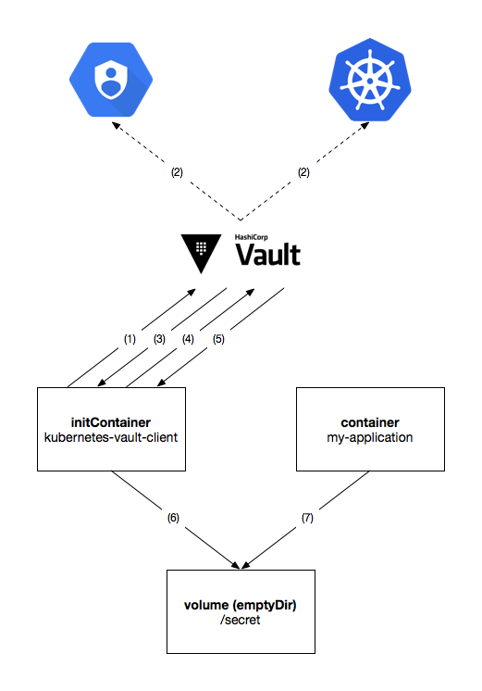
kubernetes-vault-client
Notes:
kubernetes-vault-client authenticates with Vault using a gcp or kubernetes authentication backend by sending a signed token made available to the container.
The target authentication backend verifies the authenticity of the signed token with Google Cloud IAM or the source Kubernetes cluster, respectively.
Upon successful authentication, Vault responds to kubernetes-vault-client with a Vault token that can be used to request secrets and certificates from kv and pki secret backends, respectively.
kubernetes-vault-client then requests the necessary secrets and certificates from Vault, according to the provided configuration.
Vault responds to kubernetes-vault-client with the requested secrets and certificates.
kubernetes-vault-client then dumps these secrets and certificates into a shared volume pre-configured in the PodSpec — ideally one of type emptyDir and spec medium: Memory — and exits.
The application reads the necessary secrets and certificates from the emptyDir volume when necessary.

Slide 123
Example: time-server

Slide 124

Example: time-server
One will now walk through the steps necessary to transform an insecure web application — one that stores credentials in the code and does not use TLS — into a secure application that reads secrets and TLS certificates from Vault.
The application used as an example is a simple HTTP time server that responds to GET / requests with the current date and time.

Slide 125
Example: time-server
The code for this example lives at
https://github.com/travelaudience/kubernetes-vault-example
The code and policies in the repo are intentionally very restrictive (and thus more secure). They serve as a reference of what things should look like in a production scenario.
However, and in order to ease things during this training, we will use slightly different, more permissive policies.

Slide 126
Provision the time-server credentials as a secret
$ vault write secret/time-server-credentials \
username="time-client" \
password="safe#passw0rd!"
Success! Data written to: secret/time-server-credentials

Slide 127
Create PKI role for time-server
$ vault write intermediate-ca/roles/time-server \
allowed_domains="time-server.default.svc.cluster.local,time-server.default,time-server" \
allow_subdomains="false" \
allow_bare_domains="true" \
max_ttl="2160h" \
client_flag="false"
Success! Data written to: intermediate-ca/roles/time-server

Slide 128
Create PKI role for time-client
$ vault write intermediate-ca/roles/time-client \
allowed_domains="time-client" \
allow_subdomains="false" \
allow_bare_domains="true" \
max_ttl="2160h" \
server_flag="false"
Success! Data written to: intermediate-ca/roles/time-client

Slide 129
Create the time-server policy
$ cat <<EOF > time-server.hcl
path "secret/time-server-credentials" { capabilities = ["read"] }
path "intermediate-ca/issue/time-client" { capabilities = ["create","update"] }
path "intermediate-ca/issue/time-server" { capabilities = ["create","update"] }
EOF
$ vault write sys/policy/time-server policy=@time-server.hcl
Success! Data written to: sys/policy/time-server

Slide 130
Enable the kubernetes authentication backend
$ KUBERNETES_HOST=$(gcloud container clusters describe gke-1 \
--format json --project training-235717 \
| jq -r .endpoint)
$ KUBERNETES_CA_CERT=$(gcloud container clusters describe gke-1 \
--format json --project training-235717 \
| jq -r .masterAuth.clusterCaCertificate | base64 -D)

Slide 131
Enable the kubernetes authentication backend
$ vault auth-enable --path "training-235717-gke-1" kubernetes
Successfully enabled 'gcp' at 'training-235717-gke-1'!
$ vault write auth/training-235717-gke-1/config \
kubernetes_host="https://${KUBERNETES_HOST}" \
kubernetes_ca_cert="${KUBERNETES_CA_CERT}"
Success! Data written to: auth/training-235717-gke-1/config

Slide 132
Configure RBAC to allow authentication
apiVersion: rbac.authorization.k8s.io/v1
kind: ClusterRoleBinding
metadata:
name: tokenreview-binding
roleRef:
apiGroup: rbac.authorization.k8s.io
kind: ClusterRole
name: system:auth-delegator
subjects:
- kind: ServiceAccount
name: default
namespace: default
$ gcloud container clusters get-credentials \
gke-1 \
--project training-235717
$ kubectl create -f tokenreview-binding.yaml
clusterrolebinding "tokenreview-binding" created
Notes:
gcloud container clusters get-credentials gke-1 --project training-235717
Paste the code on the left into a tokenreview-binding.yaml file.

Slide 133
Create the time-server role in the auth backend
$ vault write auth/training-235717-gke-1/role/time-server \
bound_service_account_names="default" \
bound_service_account_namespaces="default" \
policies="default,time-server" \
period="60s"
Success! Data written to: auth/training-235717-gke-1/role/time-server

Slide 134
Initial example
Code

Slide 135
Initial example
$ kubectl create -f 01-initial-example/01-time-server.yaml
statefulset "time-server" created
service "time-server" created
$ kubectl create -f 01-initial-example/02-time-client.yaml
statefulset "time-client" created
$ kubectl get pod
NAME READY STATUS RESTARTS AGE
time-client-0 1/1 Running 0 1m
time-server-0 1/1 Running 0 1m

Slide 136
Initial example
$ kubectl logs time-server-0
2017/12/06 12:33:33 got time request from 'time-client'
2017/12/06 12:33:38 got time request from 'time-client'
$ kubectl logs time-client-0
2017/12/06 12:33:33 got time from server: 2017-12-06T12:33:33Z
2017/12/06 12:33:38 got time from server: 2017-12-06T12:33:38Z

Slide 137
Initial example (cleanup)
$ kubectl delete statefulset time-client
$ kubectl delete statefulset time-server
$ kubectl delete service time-server

Slide 138
Using secrets from Vault
Code

Slide 139
Using secrets from Vault
$ kubectl create -f 02-using-secrets-from-vault/01-configmap.yaml
configmap "kubernetes-vault-client-02" created
$ kubectl create -f 02-using-secrets-from-vault/02-time-server.yaml
statefulset "time-server" created
service "time-server" created
$ kubectl create -f 02-using-secrets-from-vault/03-time-client.yaml
statefulset "time-client" created
$ kubectl get pod
(...)

Slide 140
Using secrets from Vault
$ kubectl logs time-server-0 kubernetes-vault-client
time="2017-12-06T13:02:39Z" level=info msg="vault: auth successful"
time="2017-12-06T13:02:40Z" level=info msg="initC: dump successful"
$ kubectl logs time-client-0 kubernetes-vault-client
time="2017-12-06T13:03:22Z" level=info msg="vault: auth successful"
time="2017-12-06T13:03:23Z" level=info msg="initC: dump successful"
$ kubectl exec time-server-0 -- cat /secret/username
time-client
$ kubectl exec time-server-0 -- cat /secret/password
safe#passw0rd!

Slide 141
Using secrets from Vault (cleanup)
$ kubectl delete statefulset time-client
$ kubectl delete statefulset time-server
$ kubectl delete service time-server
$ kubectl delete configmap kubernetes-vault-client-02

Slide 142
Using certificates from Vault
Code

Slide 143
Using certificates from Vault
$ kubectl create -f 03-using-certificates-from-vault/01-configmap.yaml
configmap "kubernetes-vault-client-03" created
$ kubectl create -f 03-using-certificates-from-vault/02-time-server.yaml
statefulset "time-server" created
service "time-server" created
$ kubectl create -f 03-using-certificates-from-vault/03-time-client.yaml
statefulset "time-client" created
$ kubectl get pod
(...)

Slide 144
Using certificates from Vault
$ kubectl logs time-server-0 kubernetes-vault-client
time="2017-12-06T13:44:04Z" level=info msg="vault: auth successful"
time="2017-12-06T13:44:04Z" level=info msg="initC: dump successful"
$ kubectl logs time-client-0 kubernetes-vault-client
time="2017-12-06T13:44:06Z" level=info msg="vault: auth successful"
time="2017-12-06T13:44:06Z" level=info msg="initC: dump successful"
$ kubectl exec time-server-0 -- ls /secret
chain.pem
crt.pem
key.pem

Slide 145
Using secrets from Vault (cleanup)
$ kubectl delete statefulset time-client
$ kubectl delete statefulset time-server
$ kubectl delete service time-server
$ kubectl delete configmap kubernetes-vault-client-03

Slide 146
Questions?

